Slide 1
Parallel Computer Architectures

Slide 2

Parallel Processing
Not possible: Building a computer with one CPU and a cycle time of 0.001 ns
Moore’s Law’s limits have been reached
Possible: Building a computer with 1000 CPUs, each with a cycle time of 1 ns
Use all of them in some manner: Parallel processing
Example: Hadoop cluster
Master node
Slave nodes

Slide 3
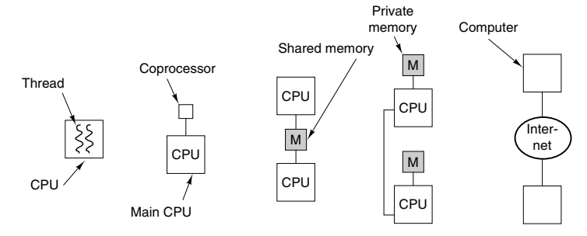
Parallel Processing Types/Levels
On-chip parallelism: Instruction-level parallelism, Multithreading, Single-chip multiprocessors
Coprocessors: Extra CPU boards with additional processing capacity (Network, Multimedia, Cryptography)
Multiprocessor: Multiple CPUs, shared memory
Multicomputer: Multiple CPUs, Own memory
Grid computing: Connect entire organizations over the Internet

Slide 4
On-Chip Parallelism: Instruction-level parallelism
Instruction-level parallelism: Issue multiple instructions per clock cycle
Instruction-level Parallelism
Superscalar Processors
VLIW Processors

Slide 5

On-Chip Parallelism: Instruction-level parallelism
Superscalar processors
Issue up to 2-6 instructions per clock cycle
If an instruction needs a functional unit or result that is not computed, it is not issued
VLIW processors (Very Long Instruction Word)
Compiler identifies instructions that can be issued together and puts them in a bundle
Such instructions are executed together, and others as single instructions
End of a bundle is marked for clear identification
End of a bundle
L: Load, I: Integer instruction, F: Float instruction, S: Store
Various bundles

Slide 6
On-Chip Parallelism: On-Chip Multithreading
Problem with Pipelined CPUs: Cache miss results into a pipeline stall
Solution: On-chip multithreading
How? CPU manages multiple threads of control at the same time
Result: If Thread 1 is blocked, CPU can try executing Thread 2
On-Chip Multithreading
Fine-grained multithreading
Coarse-grained multithreading

Slide 7
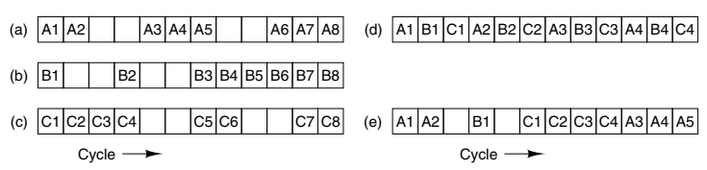
On-Chip Parallelism: On-Chip Multithreading
Fine-grained multithreading: Prevent pipeline stalls by running threads round-robin, with a different thread in consecutive clock cycles
Coarse-grained multithreading: A thread starts and continues till it stalls – Works better when number of threads is less
To (c): Three threads are running, empty slot = Stall
(d) Fine-grained multithreading
(e) Coarse-grained multithreading

Slide 8
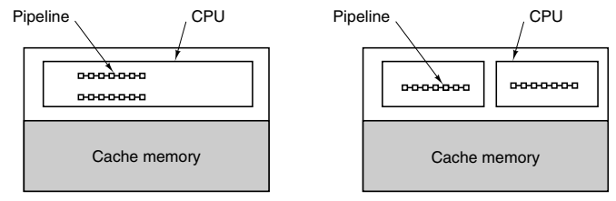
On-Chip Parallelism: Single-Chip Multiprocessors
High-end servers and consumer electronics: Better performance than multithreading is needed
Solution: Single-chip multiprocessors (e.g. Intel Core i7)
How? Put two or more powerful CPUs on a single chip
They share L2 cache and main memory, hence called multiprocessor
Two designs
One chip with two pipelines
A chip with two cores
Core: CPU/I/O controller/Cache

Slide 9
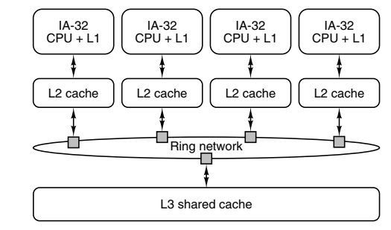
On-Chip Parallelism: Single-Chip Multiprocessors: Intel Core i7 Single-Chip Multiprocessor

Slide 10
Coprocessors
Coprocessor: Add a second, specialized processor (e.g. DMA, Graphics, I/O, Mining)
Network coprocessor: Fast packet processing using Application-Specific Integrated Circuit (ASIC), Field Programmable Gate Array (FPGA), Network processor
Graphics processor: High resolution graphics, 3D imaging using Graphics Processing Unit (GPU) resulting into Single Instruction Multiple Data (SIMD) operations
Cryptoprocessor: Encryption and decryption

Slide 11
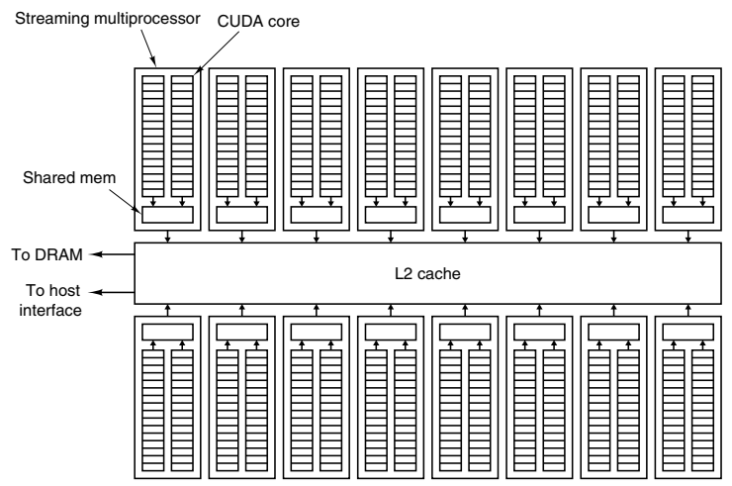
Coprocessors: NVIDIA Fermi GPU Architecture
Fermi GPU: 16 SM (Symmetric Multiprocessors)
One SM = 32 Compute Unified Device Architecture (CUDA) cores
Core = Simple processor supporting mathematical operations

Slide 12
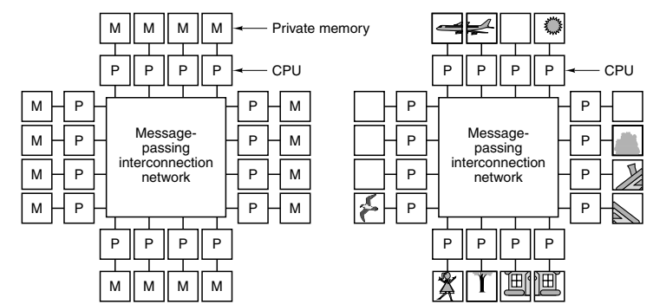
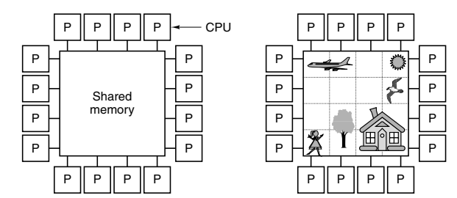
Multiprocessors and Multicomputers
Multiprocessor: All CPUs share common memory, Also called Symmetric Multiprocessor (SMP)
Multicomputer: Each CPU has its private memory, To communicate with other CPUs, need message passing

Slide 13
Parallel Computers Terminology
Instruction Streams | Data Streams | Name | Examples
1 | 1 | SISD | Classical von Neumann machine
1 | Multiple | SIMD | Vector supercomputer, Array processor
Multiple | 1 | MISD | None
Multiple | Multiple | MIMD | Multiprocessor, Multicomputer

Slide 14
Multiprocessor Classification
Uniform Memory Access (UMA): Each CPU has the same access time to every memory module
Non Uniform Memory Access (NUMA): Memory closer to a CPU can be accessed faster, than memory which is at a distance

Slide 15
Message Passing
Multicomputers (Distributed memory): Message Passing Interface (MPI)
Message passing functions
MPI_Send (buffer, count, data_type, destination, communicator)
MPI_Recv (&buffer, count, data_type, source, tag, communicator, &status)
Coarse-grained parallelism (Process-level)
Multiprocessors (Shared memory): OpenMP
Use of shared variables to communicate, Directive-based
Fine-grained parallelism (Thread-level)

Slide 16
Grid Computing
Grid computing: Very large, international, loosely-coupled heterogeneous cluster

Slide 17
NVLink
NVLink (NVIDIA Link): High-speed, high-bandwidth interconnect technology developed by NVIDIA for connecting various components within a computer system, particularly in data center and high-performance computing (HPC) environments
Faster and more efficient communication GPU-GPU, CPU-GPU, and GPUs-Other components
Faster than PCI Express
High bandwidth, low latency

Slide 18
An Overview of Latest Processors

Slide 19
Intel 32-bit and 64-bit Processors
Point | 32-bit processor | 64-bit processor
Architecture | X86 family, works with data and instructions that are 32-bit long | X86-64 or AMD64 family, works with data and instructions that are 64-bit long
Memory addressing | 2^32 i.e. 4GB memory addresses can be accessed | 2^64 i.e. 18.4 million TB memory addresses can be accessed
Software compatibility | Compatible with 32-bit and 16-bit software | Compatible with 64-bit and 32-bit software
Performance | Struggle with memory-intensive applications | Suitable for memory-intensive applications using multi-core
Limitations | 4GB RAM, Handling large data sets is slow | None at the moment

Slide 20
Generations of Intel Core Processors
Generation | Year | Brand names
First (Nehalem) | 2008 | Core i7, Core i5, Core i3
Second (Sandy Bridge) | 2011 | Intel Quick Sync Video
Third (Ivy Bridge) | 2012 | -
Fourth (Haswell) | 2013 | -
Fifth (Broadwell) | 2014 | -
Sixth (Skylake) | 2015 | -
Seventh (Kaby Lake) | 2016 | -
Eighth (Coffee Lake) | 2017 | More cores and threads in existing processors
Ninth (Coffee Lake Refresh) | 2018 | -
Tenth (Comet Lake and Ice Lake) | 2019 | -
Eleventh (Tiger Lake) | 2020 | -

Slide 21
HPC Processors: AMD, POWER, ARM
AMD, with its x86-based processors, has a significant presence in HPC, particularly in the consumer and mid-range server segments
AMD's EPYC processors have gained popularity in HPC clusters due to their competitive performance, memory bandwidth, and core counts
Key features include support for PCIe 4.0 for high-speed I/O and excellent floating-point performance
AMD's Infinity Fabric interconnect architecture allows for scalable multi-socket systems, making it suitable for a variety of HPC workloads
AMD's partnership with Cray (now part of HPE) has resulted in the development of powerful supercomputers like "Frontier" and "El Capitan"

Slide 22
HPC Processors: AMD, POWER, ARM
IBM POWER architecture is known for its high-performance computing capabilities and is used in some of the world's most powerful supercomputers
POWER processors are characterized by high core counts, significant memory bandwidth, and advanced vector processing units
IBM's Summit supercomputer, located at Oak Ridge National Laboratory, is one of the most prominent examples of POWER-based HPC systems - It was, at one point, the world's fastest supercomputer
IBM's involvement in the OpenPOWER Consortium has led to the availability of open-source hardware designs and increased adoption of POWER-based systems in HPC

Slide 23
HPC Processors: AMD, POWER, ARM
ARM processors, initially designed for mobile devices, are gaining traction in HPC due to their power efficiency and scalability
ARM-based processors, such as those from vendors like Cavium (now Marvell) and Fujitsu, are being used in HPC systems
ARM's approach to heterogeneous computing, with big.LITTLE configurations and accelerators, is well-suited for workloads that require both high performance and energy efficiency
ARM processors are often used in conjunction with GPUs or accelerators, allowing for balanced HPC systems
The ARM ecosystem's flexibility enables customized processor designs for specific HPC applications and research needs
Notable HPC Systems:
The "Fugaku" supercomputer, developed by RIKEN and Fujitsu, is currently the world's fastest supercomputer and is powered by ARM-based processors
Other ARM-based HPC systems, like the "Astra" supercomputer at Sandia National Laboratories, demonstrate the architecture's viability in the HPC space

